Slide 1
FEDERAL
TAX UPDATE
Samuel A. Donaldson
Georgia State University College of Law
Atlanta, Georgia

Slide 2
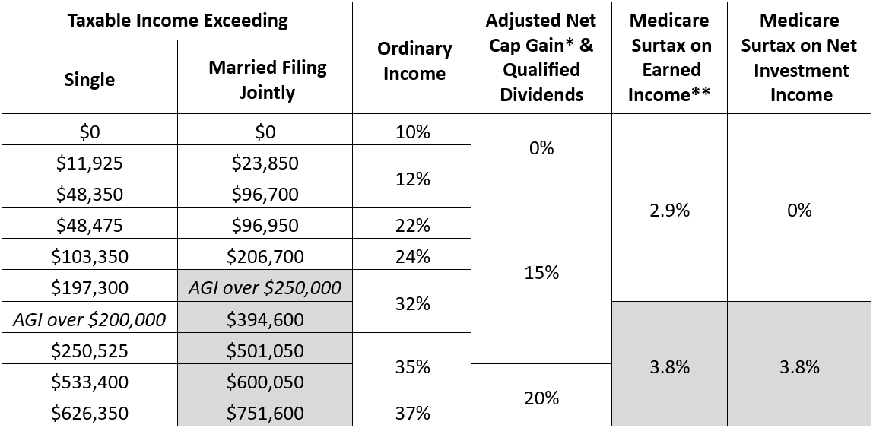
Projected 2025 Income Tax Brackets for Individuals

Slide 3
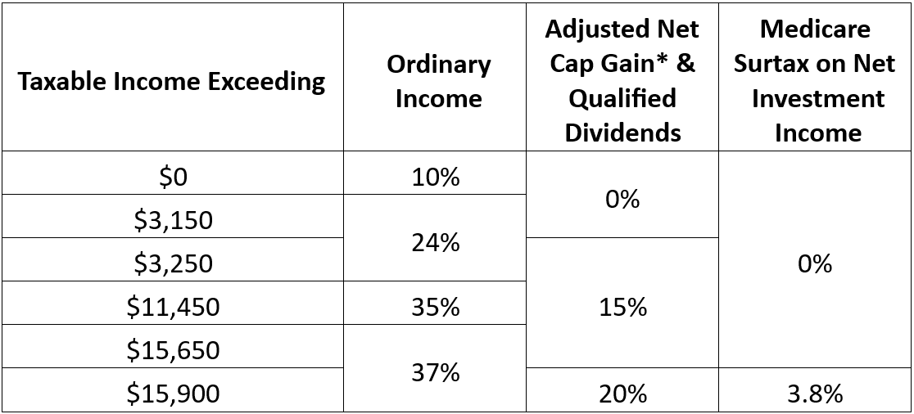
Projected 2025 Income Tax Brackets for Trusts & Estates

Slide 4
Federal Gift Tax Annual Exclusion Amount
Date of gift | Annual exclusion amount
2001 | $10,000
2002 – 2005 | $11,000
2006 – 2008 | $12,000
2009 – 2012 | $13,000
2013 – 2017 | $14,000
2018 – 2021 | $15,000
2022 | $16,000
2023 | $17,000
2024 | $18,000

Slide 5
Federal Gift Tax Annual Exclusion Amount
Date of gift | Annual exclusion amount
2001 | $10,000
2002 – 2005 | $11,000
2006 – 2008 | $12,000
2009 – 2012 | $13,000
2013 – 2017 | $14,000
2018 – 2021 | $15,000
2022 | $16,000
2023 | $17,000
2024 | $18,000
2025 | $19,000

Slide 6
Month | §7520 Rate
January 2022 | 1.6%
February 2022 | 1.6%
March 2022 | 2.0%
April 2022 | 2.2%
May 2022 | 3.0%
June 2022 | 3.6%
July 2022 | 3.6%
August 2022 | 3.8%
September 2022 | 3.6%
October 2022 | 4.0%
November 2022 | 4.8%
December 2022 | 5.2%
Month | §7520 Rate
January 2023 | 4.6%
February 2023 | 4.6%
March 2023 | 4.4%
April 2023 | 5.0%
May 2023 | 4.4%
June 2023 | 4.2%
July 2023 | 4.6%
August 2023 | 5.0%
September 2023 | 5.0%
October 2023 | 5.4%
November 2023 | 5.6%
December 2023 | 5.8%
Section 7520 Rates
Month | §7520 Rate
January 2024 | 5.2%
February 2024 | 4.8%
March 2024 | 5.0%
April 2024 | 5.2%
May 2024 | 5.4%
June 2024 | 5.6%
July 2024 | 5.4%
August 2024 | 5.2%
September 2024 | 4.8%
Oct & Nov 2024 | 4.4%

Slide 7
Federal Wealth Transfer Tax Basic Exclusion Amount
Date of death | Basic exclusion amount
2011 | $5,000,000
2012 | $5,120,000
2013 | $5,250,000
2014 | $5,340,000
2015 | $5,430,000
2016 | $5,450,000
2017 | $5,490,000
Date of death | Basic exclusion amount
2018 | $11,180,000
2019 | $11,400,000
2020 | $11,580,000
2021 | $11,700,000
2022 | $12,060,000
2023 | $12,920,000
2024 | $13,610,000

Slide 8
Federal Wealth Transfer Tax Basic Exclusion Amount
Date of death | Basic exclusion amount
2011 | $5,000,000
2012 | $5,120,000
2013 | $5,250,000
2014 | $5,340,000
2015 | $5,430,000
2016 | $5,450,000
2017 | $5,490,000
Date of death | Basic exclusion amount
2018 | $11,180,000
2019 | $11,400,000
2020 | $11,580,000
2021 | $11,700,000
2022 | $12,060,000
2023 | $12,920,000
2024 | $13,610,000
2025 | $13,990,000

Slide 9
Selected Sunsets at the End of 2025
37% top rate on ordinary income
Increased standard deduction ($14,600)
Increased AMT exemptions and thresholds
Exclusion for income from discharge of debt on principal residence
$10,000 cap on deduction for state and local taxes
Limit on personal casualty losses
60% AGI limitation on cash donations to public charities
Qualified business income deduction under §199A
$10 million (adjusted) “basic exclusion amount”
Notes:
Standard deduction in 2026 expected to be about $8,350

Slide 10
Back from the Dead in 2026
39.6% top rate on ordinary income
Miscellaneous itemized deductions
Overall limit on itemized deductions
Personal and dependency exemptions
Deduction for interest on home equity debt
Deduction for moving expenses

Slide 11
What to Expect in 2025

Slide 12
28% corporate tax rate (now 21%)
Restore 39.6% income tax rate for taxable income above $400,000 / $450,000
Expand net investment income surcharge to active business income (and raise rate to 5% for high income filers)
28% rate on long-term cap gains and dividends if taxable income exceeds $1,000,000

Slide 13
Limit like-kind exchanges of land to $500,000 in gain
Exclusion for tip income for occupations where tipping is customary
Restore child tax credit to 2021 levels
$25,000 tax credit to first-time homebuyers (over 4 years)
25% “billionaire minimum tax”?

Slide 14
$3.5 million exclusion
55%, 60%, 65% transfer tax rates
Surtax on billion-dollar estates
10-year minimum for GRATs
Estate tax on defective grantor trusts
Deemed gift on toggle of grantor trust status
Surtax on trusts with large AGIs

Slide 15
STOP THE STEAL SUNSET!
Preserve 37% top income tax bracket
Preserve $10 million basic exclusion amount
Preserve §199A deduction
Preserve SALT deduction cap

Slide 16
15% corporate tax rate
Exclude tips from gross income
Exclude social security benefits from gross income
Impose universal tariff on all imports (10% base, up to 60% for imports from China)

Slide 17
Does corporate-owned life insurance used to fund a redemption increase the estate tax value of stock?
Estate of Blount v. Commissioner (11th Cir. 2005) → NO
While the insurance is an asset, there is an offsetting liability to use the proceeds to redeem the stock
A willing seller would not accept $3.86 million for the stock when the company is about to get a $3 million death benefit
Estate of Connelly v. United States (8th Cir. June 2, 2023) → YES
Notes:
• Brothers Michael (77%) and Thomas (23%) owned a materials corp.
• Their B/S agreement = upon death of one, the other can buy or company will redeem
• Company bought $3.5 million policy on each brother
• Agreement said value would be determined by annual agreement or 2+ appraisals
• When Michael died, company paid $3M to his estate (determined in negotiation, not by agmt or appraisals
• Michael’s 706 reported value of the stock at $3M, but IRS said 77% of death benefit likewise included
Observations
Note that only 77% of death benefit included (better than if Michael owned his own policy)
Result might have ben different if they followed their own agreement! When parties don’t respect agreement, why should IRS?

Slide 18
Does corporate-owned life insurance used to fund a redemption increase the estate tax value of stock?
Estate of Blount v. Commissioner (11th Cir. 2005) → NO
While the insurance is an asset, there is an offsetting liability to use the proceeds to redeem the stock
Estate of Connelly v. United States (8th Cir. June 2, 2023) → YES
A willing seller would not accept $3.86 million for the stock when the company is about to get a $3 million death benefit
Notes:
• Brothers Michael (77%) and Thomas (23%) owned a materials corp.
• Their B/S agreement = upon death of one, the other can buy or company will redeem
• Company bought $3.5 million policy on each brother
• Agreement said value would be determined by annual agreement or 2+ appraisals
• When Michael died, company paid $3M to his estate (determined in negotiation, not by agmt or appraisals
• Michael’s 706 reported value of the stock at $3M, but IRS said 77% of death benefit likewise included
Observations
Note that only 77% of death benefit included (better than if Michael owned his own policy)
Result might have ben different if they followed their own agreement! When parties don’t respect agreement, why should IRS?

Slide 19
Moore v. United States
Is the Mandatory Repatriation Tax (“MRT”) constitutional?

Slide 20
Moore v. United States
“Whether the Sixteenth Amendment authorizes Congress to tax unrealized sums without apportionment among the states”

Slide 21
Moore v. United States
“…the MRT does tax realized income – namely, income realized by the corporation, KisanKraft. The MRT attributes the income of the corporation to the shareholders, and then taxes the shareholders (including the Moores) on their share of that undistributed corporate income.
So the precise and narrow question that the Court addresses today is whether Congress may attribute an entity’s realized and undistributed income to the entity’s shareholders or partners, and then tax the shareholders or partners on their portions of that income.”

Slide 22
Moore v. United States
“…our analysis today does not address the distinct issue that would be raised by (i) an attempt by Congress to tax both the entity and the shareholders or partners on the entity’s undistributed income; (ii) taxes on holdings, wealth, or net worth; or (iii) taxes on appreciation.”

Slide 23
Moore v. United States
The realization requirement springs not from the Sixteenth Amendment but from Eisner v. Macomber, and Helvering v. Bruun neutered Macomber’s stance on realization.
“Any litigant seeking to sustain her case on the basis of Macomber would have to bring back from the dead its Court-created limit on Congress’s power.”

Slide 24
Moore v. United States
“The question on which we granted review is ‘[w]hether the Sixteenth Amendment authorizes Congress to tax unrealized sums without apportionment among the states.’ … The answer is straightforward: No.”

Slide 25
Moore v. United States
“In Eisner v. Macomber, 252 U. S. 189 (1920), the Court explained that ‘the characteristic and distinguishing attribute of income,’ as the term is used in the Sixteenth Amendment, is that it is ‘received or drawn by the recipient (the taxpayer) for his separate use, benefit and disposal.’ Id., at 207. Because the Moores never actually received any of their investment gains, those unrealized gains could not be taxed as ‘income’ under the Sixteenth Amendment.”

Slide 26
Loper Bright Enterprises v. Raimondo
Chevron USA v. Natural Resources Defense Council, Inc., 467 U.S. 837 (1984)
A court may not second-guess or substitute its own, “better” interpretation of statute that is silent or ambiguous as to a particular matter as long as the agency’s interpretation is a reasonable one.

Slide 27
Loper Bright Enterprises v. Raimondo
“Chevron is overruled. Courts must exercise their independent judgment in deciding whether an agency has acted within its statutory authority, as the APA requires. Careful attention to the judgment of the Executive Branch may help inform that inquiry.”

Slide 28
Loper Bright Enterprises v. Raimondo
“And when a particular statute delegates authority to an agency consistent with constitutional limits, courts must respect the delegation, while ensuring that the agency acts within it. But courts need not and under the APA may not defer to an agency interpretation of the law simply because a statute is ambiguous.”

Slide 29
Corner Post, Inc. v. Board of Governors of the Federal Reserve System
When does the statute of limitations for facial challenges to a federal agency’s rule start to run?
When the agency publishes the final rule
When the plaintiff first becomes aggrieved by the rule
Fourth, Fifth, Eighth, Ninth, Federal, D.C.
Sixth

Slide 30
Estate of Anenberg v. Commissioner 162 T.C. No. 9 (May 20)
Estate of McDougall v. Commissioner 163 T.C. No. 5 (September 17)
Does a terminating distribution of QTIP to the surviving spouse, followed by the spouse’s installment sale of that property, trigger a deemed gift under §2519?

Slide 31
If participant started RMDs before death, DB must take RMDs in each of the 10 years!
Replaced life expectancy pay-out with 10-year payout for all BUT “eligible designated beneficiaries”
Surviving spouse
Participant’s minor child
Disabled beneficiary
Chronically ill beneficiary
Beneficiary less than 10 years younger than participant
The
Setting
Every
Community
Up for
Retirement
Enhancement
Act
Notice 2022-53: no penalty where DB fails to take RMDs in 2021 or 2022
Notice 2023-54: and no penalty for 2023
Notice 2024-35: and no penalty for 2024!

Slide 32
“This relief does not require taxpayers to make up missed required minimum distributions nor does it permit taxpayers to extend the 10-year deadline by which a full distribution is required to be made. For example, if an employee died in 2020, then in 2025, there are six years remaining in the 10-year period without regard to whether the designated beneficiary took distributions in 2021, 2022, 2023, or 2024. In 2030, the designated beneficiary must take a distribution of the remaining account balance.”
The
Setting
Every
Community
Up for
Retirement
Enhancement
Act

Slide 33
Participant Dies | Named Beneficiary | Applicable Withdrawal Rule
Before RBD | -none- | Anytime within 5 years
Before RBD | Designated Beneficiary | Anytime within 10 years
After RBD | -none- | Over participant’s “life expectancy”
After RBD | Designated Beneficiary | Annually over years 1 – 9 based on beneficiary’s life expectancy, then balance in year 10
Before or after RBD | Eligible Designated Beneficiary | Over beneficiary’s life expectancy
The
Setting
Every
Community
Up for
Retirement
Enhancement
Act

Slide 34
Chief Counsel Memo 202352018 (12/29/2023)
“The modification to add the tax reimbursement clause will constitute a taxable gift by the trust beneficiaries because the addition of a discretionary power to distribute income and principal to the grantor is a relinquishment of a portion of the beneficiaries’ interest in the trust.”

Slide 35
Exercise of Stock Options Might be Taxable Gift Huffman v. Commissioner, T.C. Memo. 2024-12
1993: Son pays $4 to parents for options to buy ~56% of stock in closely-held company at a price of $5 million
2007: When outsider expressed interest in acquiring the company for about $80 million, Son exercised the options; deal later fizzled
2009: Different outside buyer pays $95.75 million for the company, mostly allocated to goodwill

Slide 36
FBAR Cases
Gaynor (M.D. Florida, 9/6/23) & Hendler (S.D. New York, 9/17/24) → Penalties don’t die with decedent
Reyes (E.D. New York, 1/10/24) & Hughes (9th Cir. 8/21/24) → Reckless failure is “willful”
Schwarzbaum (11th Cir.,8/30/24) → “Willful” penalty subject to Excessive Fines Clause

Slide 37
Estate of DeMuth v. Commissioner (3d. Cir., July 12, 2023)
D’s attorney-in-fact wrote 11 annual exclusion gift checks from D’s account, but only 1 check was paid by the drawee bank before D’s death (3 others were deposited but unpaid)
AFFIRMED: While the other 10 checks would normally be included in D’s gross estate, only the value of the 7 undeposited checks will be included here because of IRS stipulation!
HELD: The 7 includible checks were not gifts causa mortis completed before death!

Slide 38
Do limited partners owe self-employment tax?
Excerpt from §1402(a):
The term “net earnings from self-employment” means the gross income derived by an individual from any trade or business carried on by such individual, less the deductions allowed by this subtitle which are attributable to such trade or business, plus his distributive share (whether or not distributed) of income or loss described in section 702(a)(8) from any trade or business carried on by a partnership of which he is a member....
(13) there shall be excluded the distributive share of any item of income or loss of a limited partner, as such, other than guaranteed payments described in section 707(c) to that partner for services actually rendered to or on behalf of the partnership to the extent that those payments are established to be in the nature of remuneration for those services;
Soroban Capital Partners LP v. Commissioner
161 T.C. No. 12
(November 28, 2023)

Slide 39
Reg. §1.170A-14(g)(6)(ii): Upon extinguishment of a conservation easement and subsequent sale, charity’s share of proceeds must equal “the proportionate value that the perpetual conservation restriction at the time of the gift, bears to the value of the property as a whole at that time. … [T]hat proportionate value of the donee’s property right shall remain constant.”
While many conservation easement deeds give charity a share of the net proceeds, the IRS reads the regulation to require that the charity receive a share of the gross proceeds.
Oakbrook Land Holdings LLC v. Commissioner (T.C. 2020) → Regulation VALID (16 – 1 vote)
Hewitt v. Commissioner (11th Cir. 2021) → Regulation INVALID
Oakbrook Land Holdings LLC v. Commissioner (6th Cir. 2022) → Regulation VALID
Valley Park Ranch LLC v. Commissioner (T.C., 3/28/2024) → Regulation INVALID (9 – 4 vote)

Slide 40
Late Tax Court Petitions
Excerpt from §6213(a):
Within 90 days … after the notice of deficiency authorized in section 6212 is mailed (not counting Saturday, Sunday, or a legal holiday in the District of Columbia as the last day), the taxpayer may file a petition with the Tax Court for a redetermination of the deficiency. … The Tax Court shall have no jurisdiction to enjoin any action or proceeding or order any refund under this subsection unless a timely petition for a redetermination of the deficiency has been filed and then only in respect of the deficiency that is the subject of such petition.
Nutt (T.C., May 2023)
Sanders (T.C., June 2023)
Culp (3d Cir., July 2023)
Sall (T.C., November 2023)
Dodson (T.C., January 2024)

Slide 41
Palermo v. United States (S.D. Fla., August 7, 2023)

Slide 42
Maggard v. Commissioner, T.C. Memo. 2024-77 (August 7)
Taxpayer owns 40% of an S corporation, but the company is controlled by embezzlers
Taxpayer’s lawyer asks CFO for Taxpayer’s share of net loss and receives the number “$300,000,” written on a napkin!
When the IRS determines the company had net income, Taxpayer argues that disproportionate distributions terminated the S election!

Slide 43
Estate of Caan v. Commissioner 161 T.C. No. 6 (October 18, 2023)
2015: Caan’s financial advisor leaves UBS for Merrill Lynch, orders UBS to sell Caan’s interest in a hedge fund, and asks UBS to transfer the cash proceeds to Merrill Lynch
2016: UBS makes cash transfer to Merrill Lynch

Slide 44
OTHER CASES OF NOTE

